Slide 1
Brand you
By: Matthew Garza

Slide 2


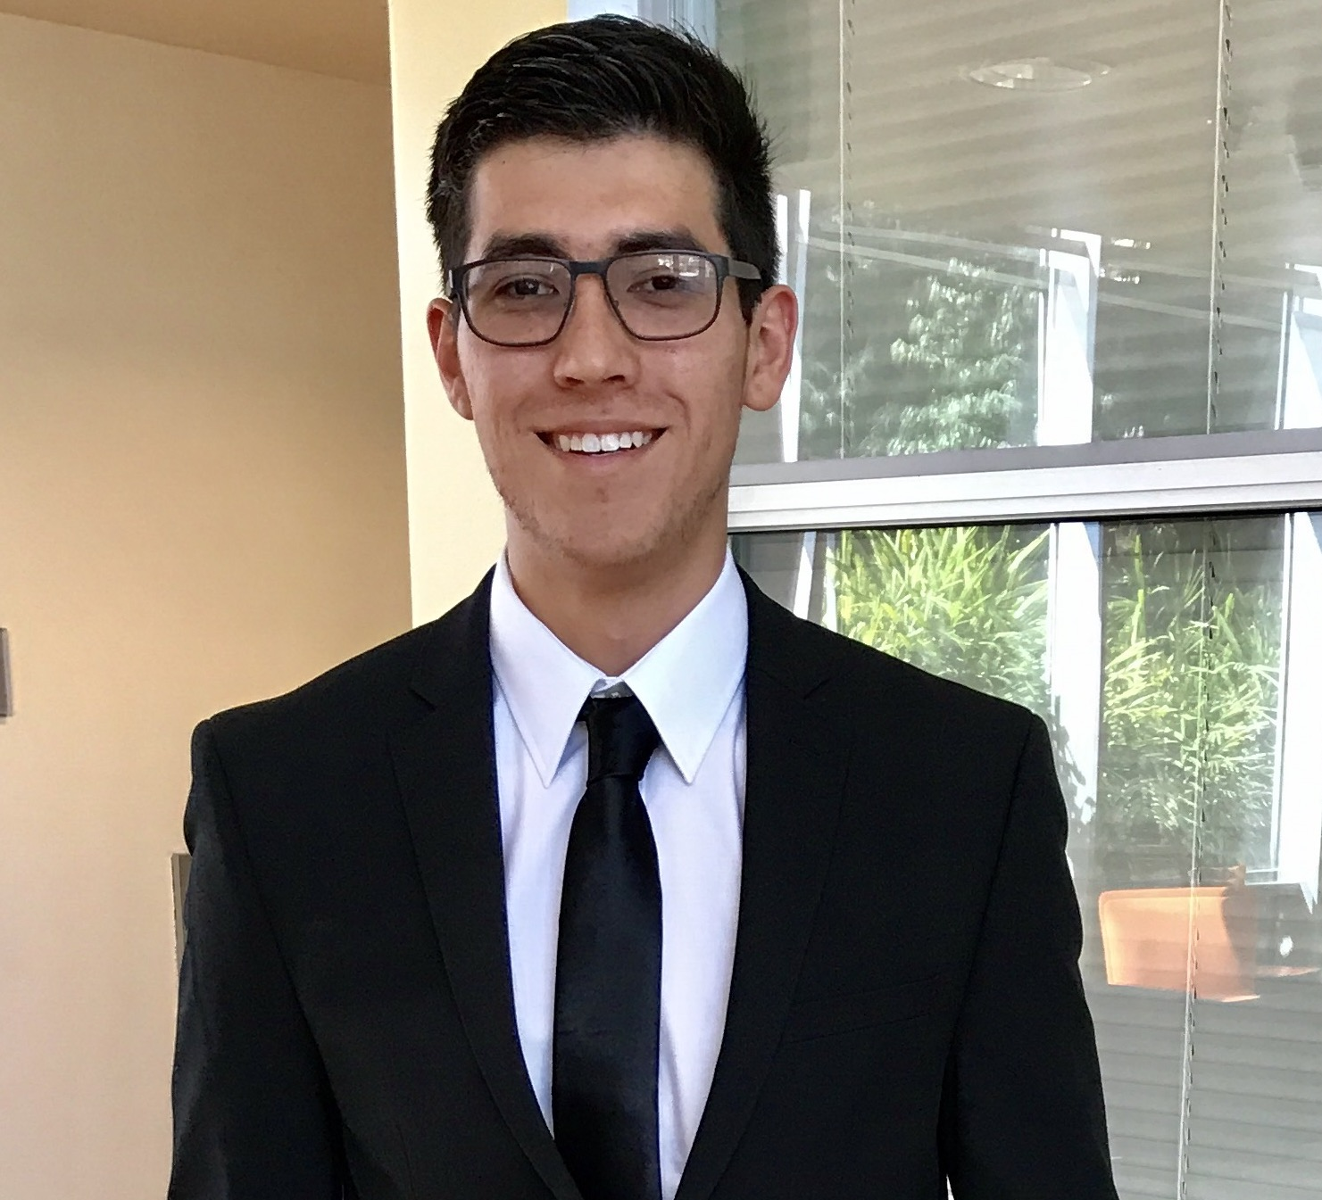
Unique sELLING PROPOSITION
I’ve been working since the age of 14.
I work full time for Costco Wholesale, and am also a full time student.
Driven to be the best through dedication and hard work.

Slide 3


Slide 4
Trigger words
Determined
Motivated
Responsible
Respectful
Kind
Diligent
Timely
Leader
Direct

Slide 5
Benefits
How I will add value to others:
-Include everyone
-listen to ideas
-Help them grow by being honest
What people will uniquely experience from my involvement:
-A strong team presence
-Value
-Enrichment
What I hope people say about me:
-I listened
-I took advice
-I stepped up to the challenge

Slide 6
Brand management
Advancing My Brand
- Social Media
- Networking
- Working
-Staying in contact with mentors
Staying Relevant
- Social Media
- Attending conferences or seminars
- Paying attention to the business world and the news

Slide 7
Brand association
The success of Apple

Slide 8
Brand association
The success of Apple
The cleverness of Facebook

Slide 9
Brand association
The success of Apple
The cleverness of Facebook
The quickness of Amazon

Slide 10
Brand association
The success of Apple
The cleverness of Facebook
The quickness of Amazon
The love and reliability of a Subaru

Slide 11
Board of directors
Curt Andre

Slide 12

Core values
Honesty
Trustworthiness
Dependability
On-time
Being Humble
These values influence how I will lead because they are essential to having strong character and running a strong business.

Slide 13
Brand promise
Personality: I have good energy and high intensity, ready to tackle any assignment!
Functions: I am here to serve others in a timely, accurate and hard-working manner.
Rewards: You will receive my best work and assistance, always.
Values: I will do everything with honesty, so that you can trust and depend on me.
Features: You can count on me because I always come through in the end and accept any challenge – if I don’t meet your needs by the end, I’d love to talk about it with you.

Slide 14
Brand Voiceover

