Slide 1
Team Chester
Matthew Garza, Austin Herrmann, Edgar Ramos Jr.

Slide 2
Team Goals Bible Verses
To be cooperative and accommodating with each other’s schedules
Create and maintain a solid foundation and build from that
Identify things that the company needed to work on in order to improve every round
Ecclesiastes 4:9-10
  “Two are better than one, because they have a good reward for their toil. For if they fall, one will lift up his fellow.”
Psalms 37:23-24
  “The steps of a man are established by the Lord, when he delights in his way; though he fall, he shall not be cast headlong, for the Lord upholds his hand.”
Notes:
Austin and Matt

Slide 3

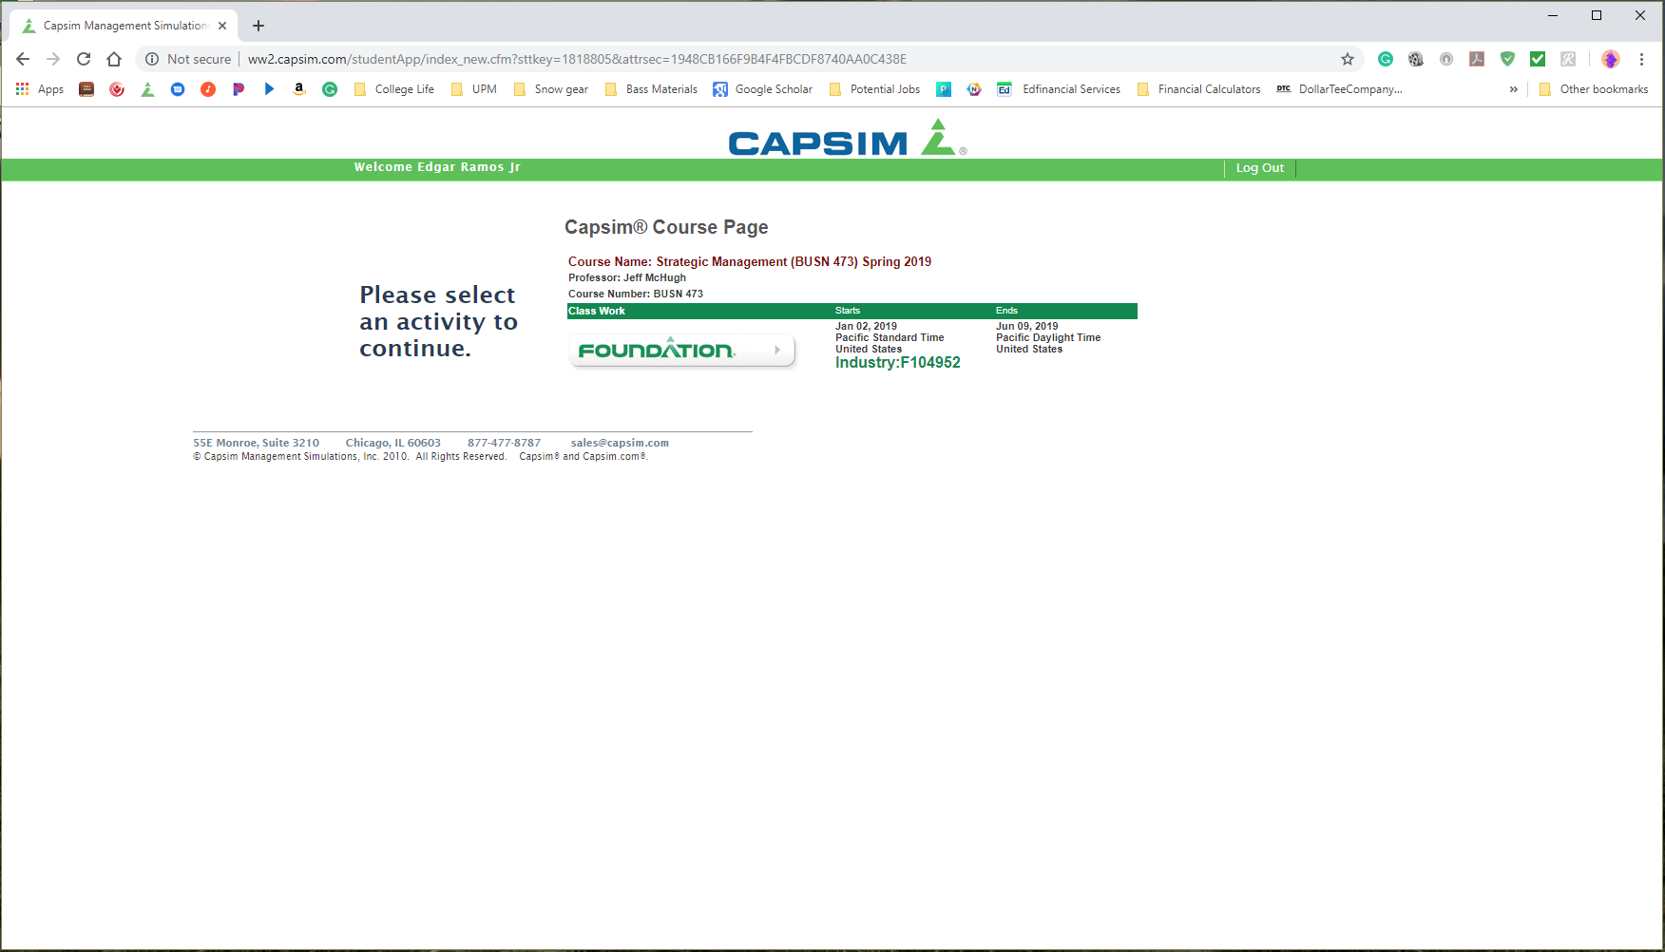

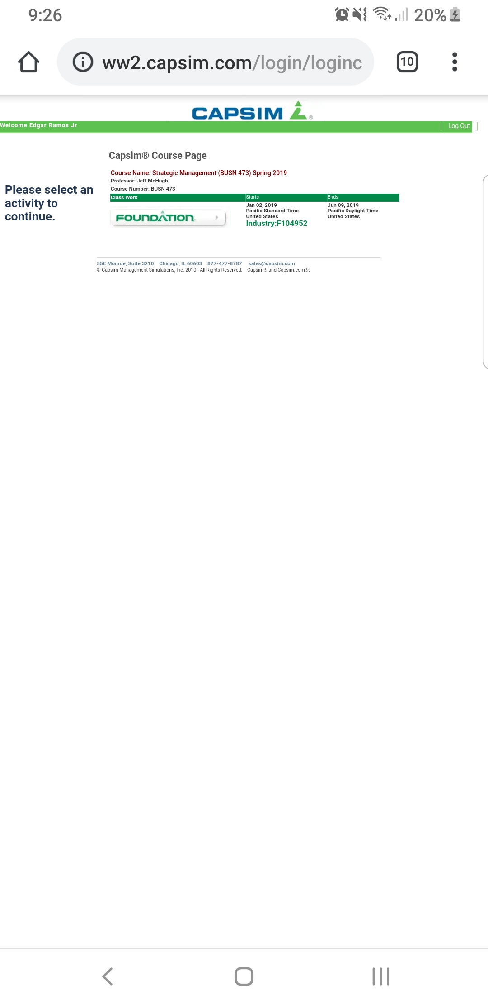
Capsim Strategy
Specializing: Low & High Market Product
Low Market: Low Price w/ reliability & High Market: High price & bugs to fix.
Investing in TQM & HR helped release more cash we can invest into other areas
Divided up the two lower and higher ends of the market & ended with four products to cover more.
Notes:
Edgar

Slide 4
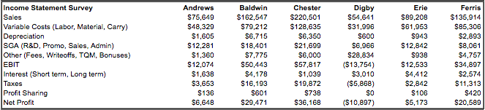
Notes:
Austin

Slide 5
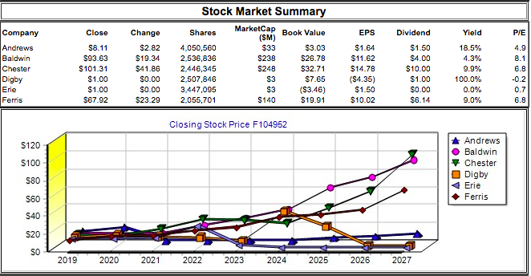
Notes:
Matt

Slide 6
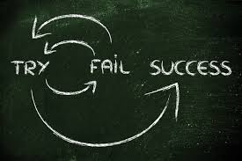
Lessons Learned
How the multiple facets of a business are more intertwined than we realized
That we needed to adjust to the fluctuations of the company
  Ex. We were hemorrhaging Cash until Round 5, in which we dropped to zero Cash, but then we came back and had the most amount of Cash out of any round after Round 6
The one thing we agreed we’d do differently was correct the amount of capacity, as we had more production than capacity out of any of the teams
Notes:
Austin

Slide 7
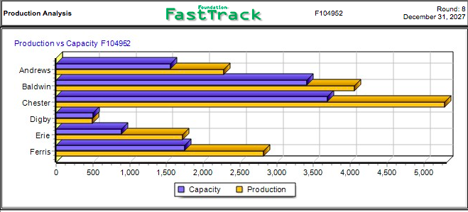
Notes:
Austin

Slide 8
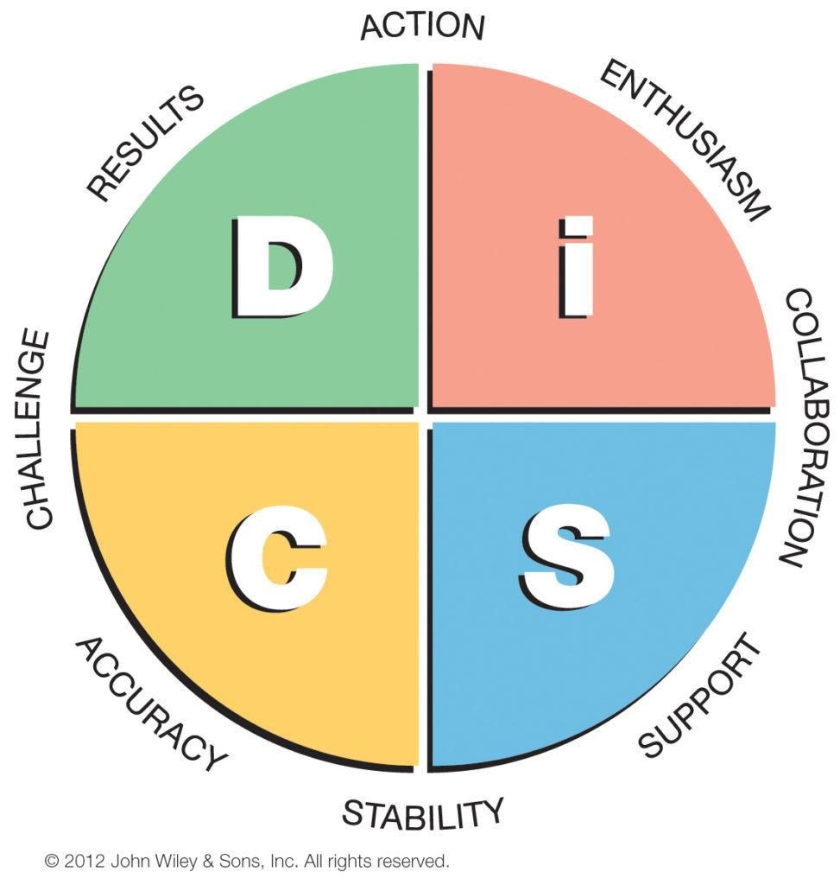
Team Dynamics
No storming phase because we all had the same mindset going into this project
Made decisions by talking about the different options and were open to different ideas
Decided to go high-tech at the very beginning and stuck with it
Didn’t lose sight of the team goals
Notes:
Edgar

Slide 9
ThankYou !!

